Slide 1

Java EE – Spring & RDBMS

Slide 2
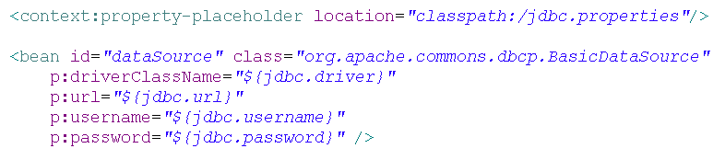
Java EE – Spring & RDBMS
Spring datasource configuration
Alternative datasources:
DriverManagerDatasource – built-in Spring dataSource
c3p0 – another data source pool
MySQL data sources

Slide 3
Java EE – Spring & RDBMS
PropertyPlacegolderConfigurer?
public class PropertyPlaceholderConfigurer implements BeanFactoryPostProcessor
A property resource configurer that resolves placeholders in bean property values of context definitions. It pulls values from a properties file into bean definitions.
A BeanFactoryPostProcessor allows for custom modification of an application context's bean definitions, adapting the bean property values of the context's underlying bean factory. Application contexts can auto-detect BeanFactoryPostProcessor beans in their bean definitions and apply them before any other beans get created.

Slide 4
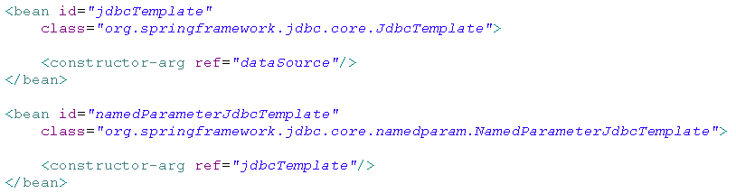
Java EE – Spring & RDBMS
JDBC support

Slide 5
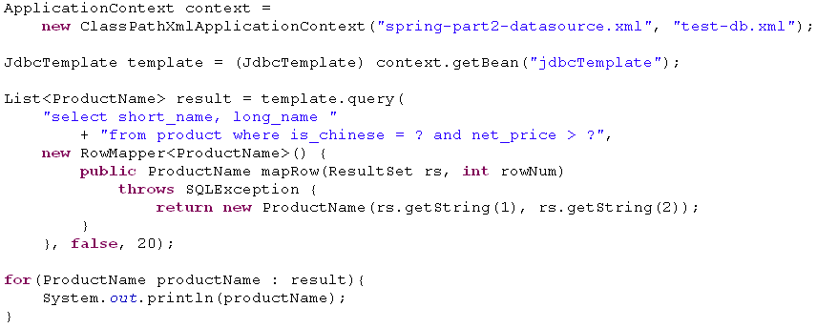
Java EE – Spring & RDBMS
JDBC Support

Slide 6
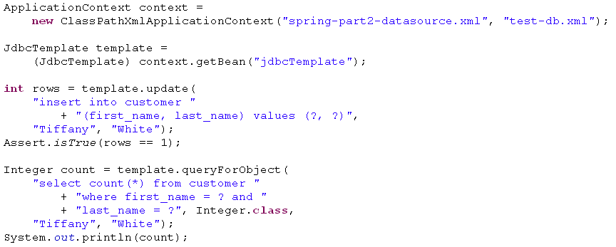
Java EE – Spring & RDBMS
Insert

Slide 7
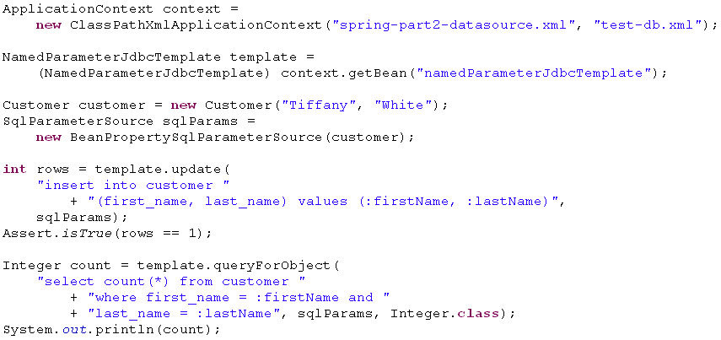
Java EE – Spring & RDBMS
NamedParameterJdbcTemplate insert

Slide 8
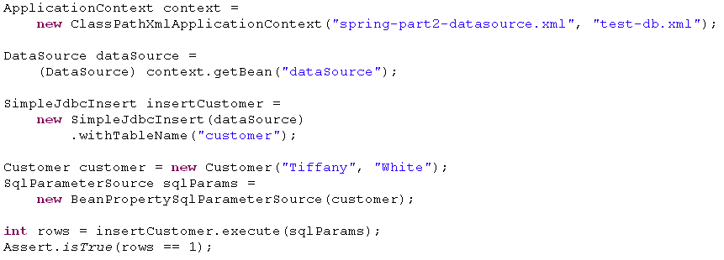
Java EE – Spring & RDBMS
SimpleJdbcInsert

Slide 9
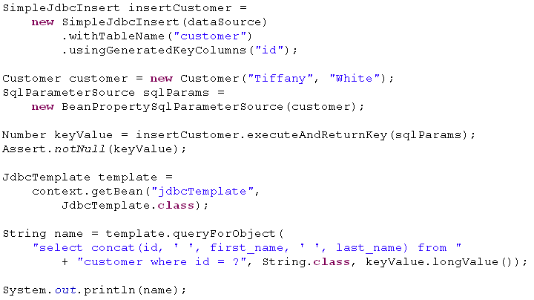
Java EE – Spring & RDBMS
SimpleJdbcInsert + get the generated key

Slide 10
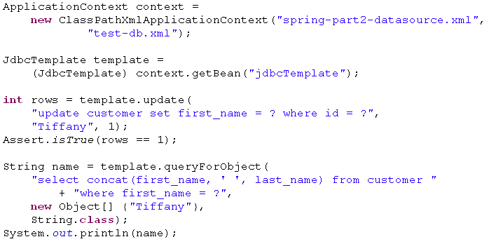
Java EE – Spring & RDBMS
Update

Slide 11
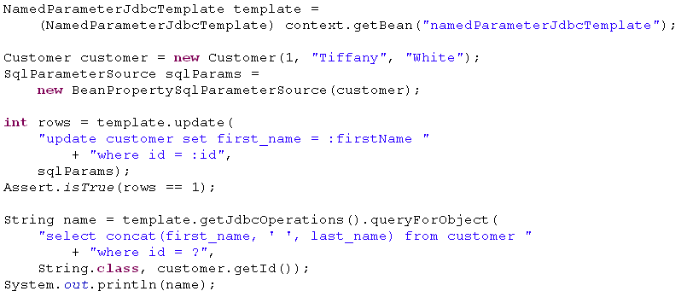
Java EE – Spring & RDBMS
NamedParameterJdbcTemplate update

Slide 12
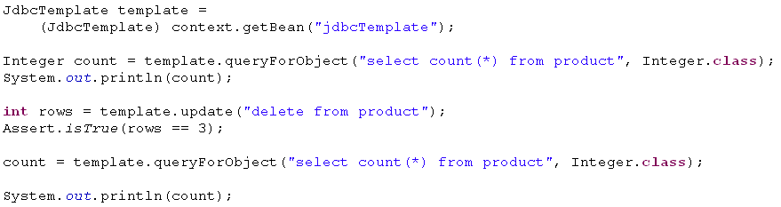
Java EE – Spring & RDBMS
Delete

Slide 13
Java EE – Spring & RDBMS
Hints
Connection object is bound to thread
Use DataSourceUtils.getConnection(DataSource dataSource)
Use DataSource.getConnection() only if the dataSource instance is a TransactionAwareDataSourceProxy
JdbcTemplate and NamedParameterJdbcTemplate throw unchecked exceptions
The root exception is DataAccessException
Extend JdbcDaoSupport or NamedParameterJdbcDaoSupport classes for your custom DAO classes

Slide 14
Java EE – Spring & RDBMS
Declarative transaction management
@Transactional
Isolation
Propagation
Timeout
rollBackFor
rollBackForClassName
noRollbackFor
noRollBackForClassName
By default
Any unchecked exception triggers a rollback
Any checked exception cause a commit

Slide 15
Java EE – Spring & RDBMS
Propagation
Required
Use existing transaction
Start new if none exist
Requires new
Start new transaction anyway
Mandatory
Use existing transaction
Throw exception when none exist
Nested
Use savepoints, rollback to savepoint if nested transaction failed
Not supported
Suspend existing transaction
Execute DB operations outside transaction
Never
Throw exception if there is an active transaction

Slide 16
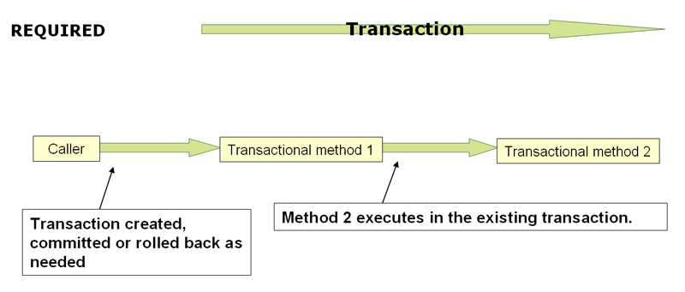
Java EE – Spring & RDBMS
Propagation required

Slide 17
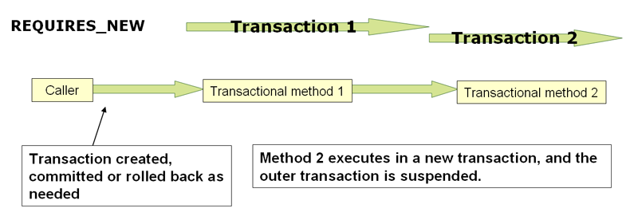
Java EE – Spring & RDBMS
Propagation requires new

Slide 18
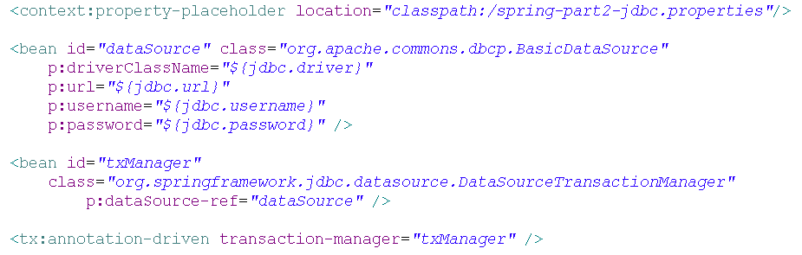
Java EE – Spring & RDBMS
Declarative transaction management configuration

Slide 19
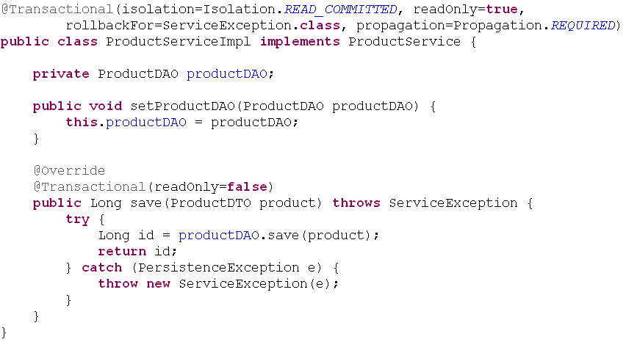
Java EE – Spring & RDBMS
Transactional annotation in action

Slide 20
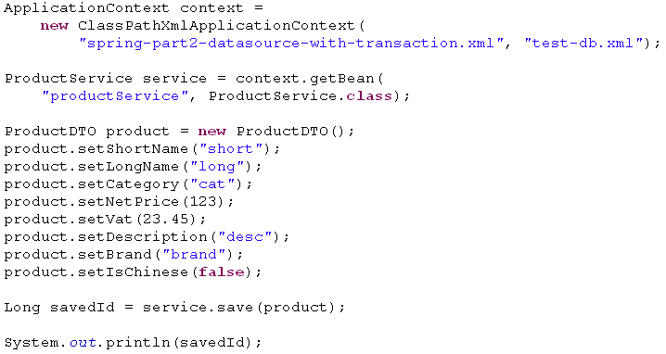
Java EE – Spring & RDBMS
Client code

Slide 21

Java EE – Spring & RDBMS
Without transaction

Slide 22
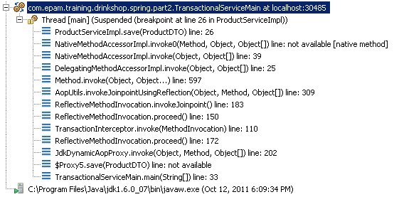
Java EE – Spring & RDBMS
With transaction

Slide 23

KÖSZÖNÖM A FIGYELMET!
Kis Bertalan
Bertalan_Kis@epam.com

